Slide 1
Access and Inclusion – Disability Action Plan 2021 -2026
Engaging early years children in the action plan consultation

Slide 2
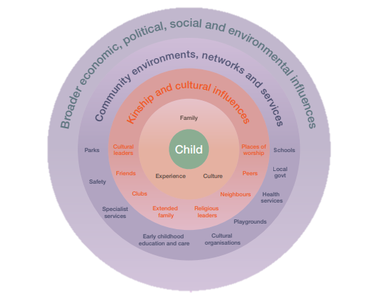
Access and Inclusion - Disability Action Plan 2021 – 2026 Information sheet for educators Engaging early years children in the action plan consultation
We are consulting for Cardinia Shire’s new Disability Action Plan.
We are committed to listening to children’s voices in Cardinia Shire, ensuring that children are given opportunities to be their best, and that they are valued, respected, celebrated and heard
We need your help to reach as many children as possible.
Council’s work aligns with the Victorian Early Years Framework:
Outcome 1. Children have a strong sense of identity
Outcome 2. Children are connected with and contribute to their world
Outcome 3. Children have a strong sense of wellbeing
Outcome 4. Children are confident and involved learners
Outcome 5. Children are effective communicators
Victorian Early Years Framework, 2017.

Slide 3
Setting the scene….
Talk about where the children live, what they do on the weekends, who they are with, exploring their community, not their physical house, but more about the community they live in.
Read stories and use picture story books that are about disability, diversity and inclusion
Activity
Use the emoji’s on the next pages to explain disability and inclusion.
Ask: What do you like most about the places you go and the things you do to with your family, friends, near your house?
This question will provide insight into what the children enjoy about where they live and what they enjoy doing (inclusion).
Ask: How can we include our friends with disability?
This question will assist us to identify what we can do to be more inclusive for people with disability.

Slide 4
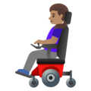
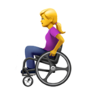
Disability is how people:
Move
Hear
See
Talk
Understand the world

Slide 5
Inclusion is how people can do things and join in:

Slide 6
Disability Inclusion =
Disability Inclusion =
How can we include our friends with disability? Draw, colour or write

Slide 7
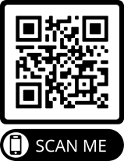
Thank you for helping us out Consultation Closes 6 June, 2021
Please Submit all responses to:
accessandinclusions@cardinia.vic.gov.au
If you have any questions, please don’t hesitate in contacting us:
Kate Beveridge
email: k.beveridge@cardinia.vic.gov.au
Phone: 1300 787 624
Emily Tuck
email: e.tuck@cardinia.vic.gov.au
Phone: 1300 787 624
Visit the Access and Inclusion Disability action plan web page: Creatingcardinia.vic.gov.au/disability-action-plan

